Slide 1
Searching For An Economic Developer Without A Search Firm? 5-Step Checklist To Making A Good Hire

Slide 2

Who is Next Move Group?

Slide 3
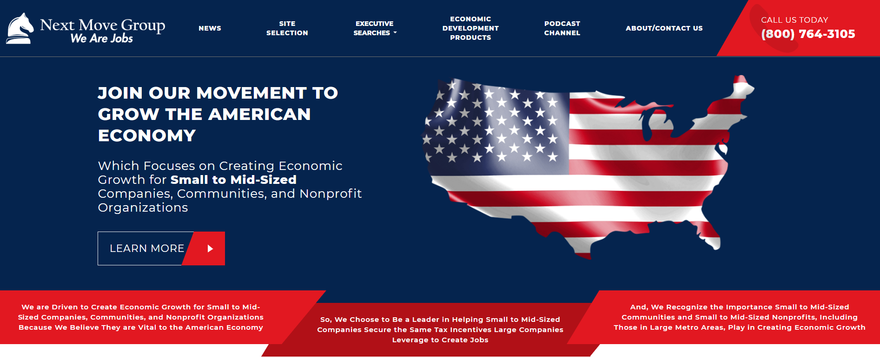
3

Slide 4
Sampling Of Economic Development Executive Search Clients

Slide 5





Sampling of Our Economic Development Clients By Type:
Iowa
5

Slide 6
5-Step Checklist To Making A Good Hire:
1) Where Should You Advertise The Job?

Slide 7
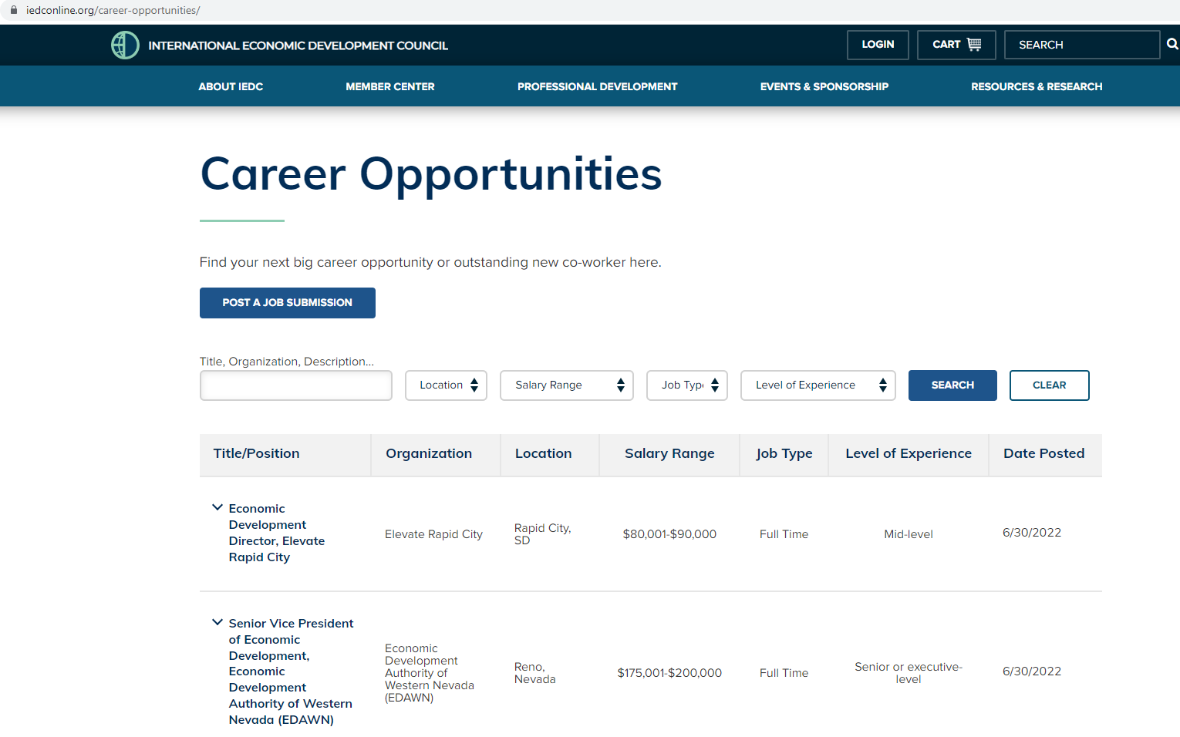
Where Should You Advertise The Job?
www.iedconline.org
2. Visit here to find: https://www.iedconline.org/pages/state-regional-and-provincial-association-partners/
Regional “Economic Development Council”
State “Economic Development Association”
3. LinkedIn/Facebook/Twitter

Slide 8
5-Step Checklist To Making A Good Hire:
2) What Should Your Job Profile Look Like?

Slide 9
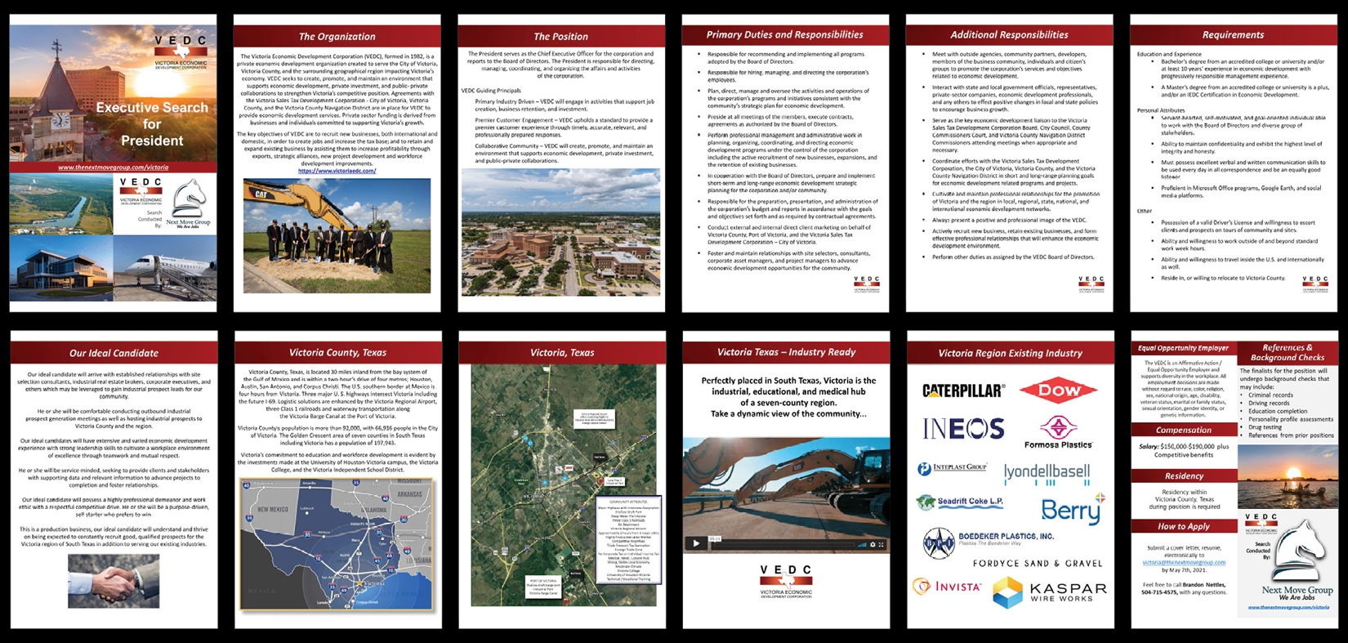
What Should Your Job Profile Look Like?

Slide 10
5-Step Checklist To Making A Good Hire:
3) Use Video Technology To Preview Candidates

Slide 11

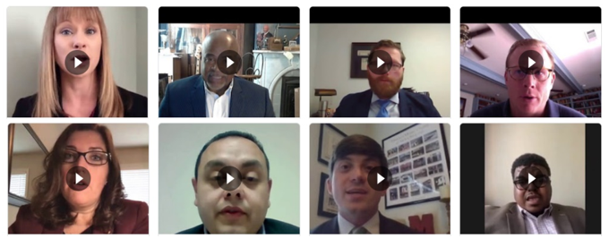
Use Video Technology To Preview Candidates
Have applicants record and send you a 2-minute video of themselves with their resume in which they tell you:
Why they want the job
What their qualifications are
And describe themselves

Slide 12
5-Step Checklist To Making A Good Hire:
4) Run Background Checks On All Finalists

Slide 13
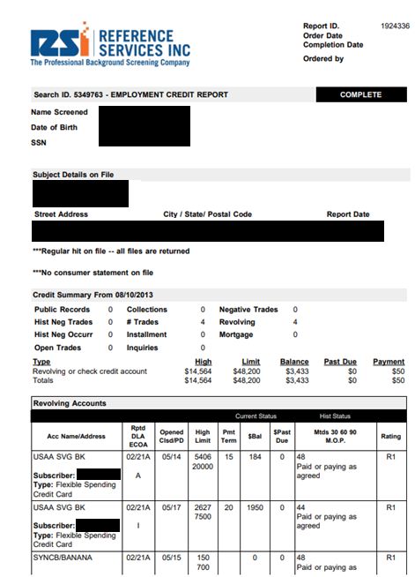
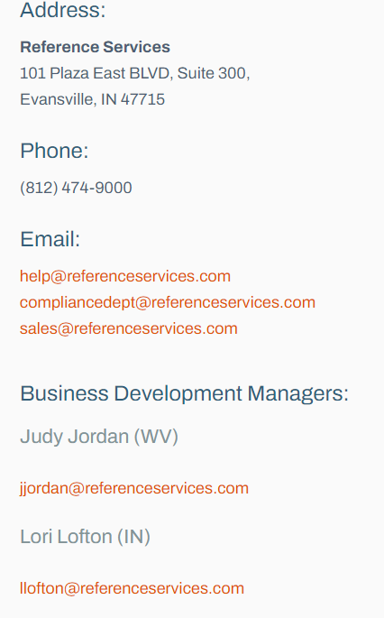
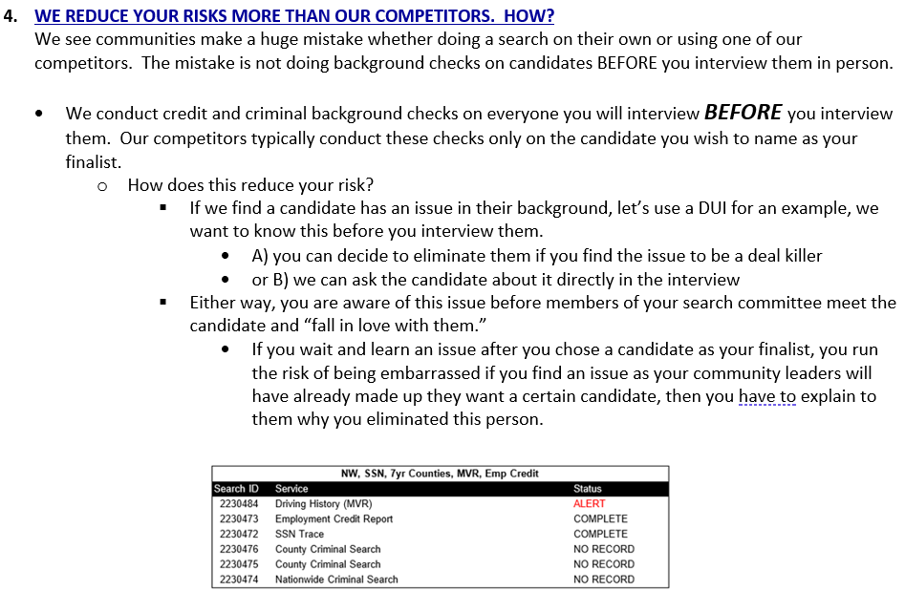
Run Background Checks On All Finalists

Slide 14
5-Step Checklist To Making A Good Hire:
5) Interview In 3 Different Settings

Slide 15
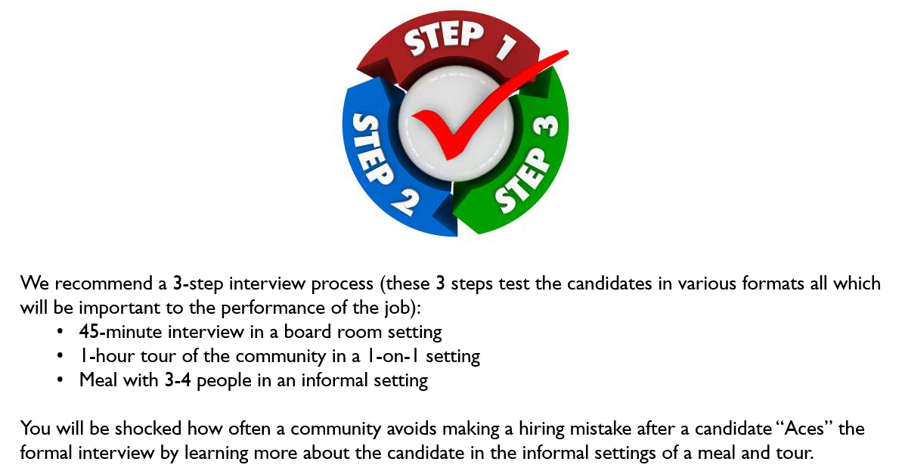
Interview In 3 Different Settings

Slide 16
Testimonials

Slide 17

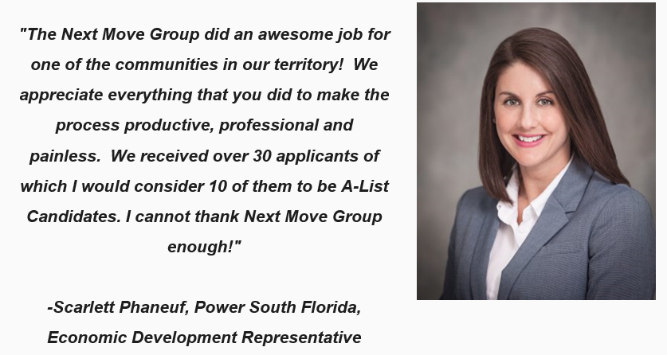
Testimonials:

Slide 18
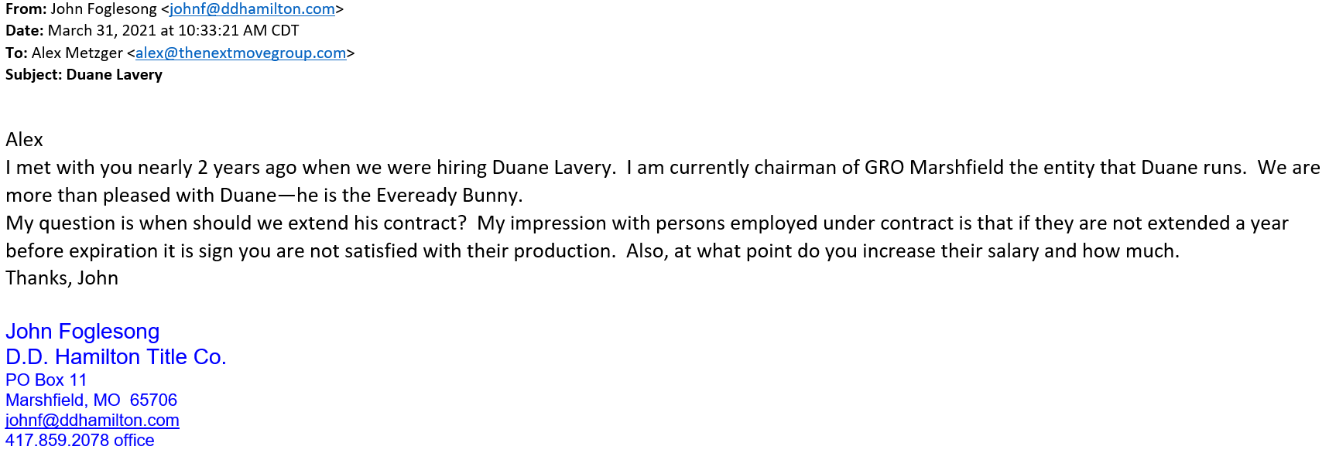

Testimonials:

Slide 19
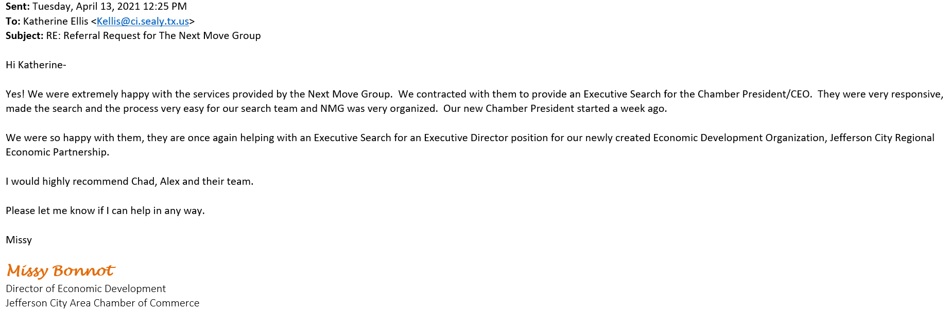

Testimonials:

Slide 20
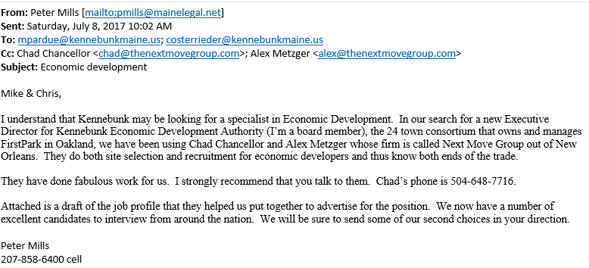
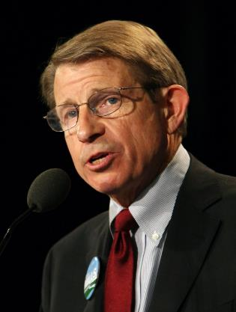


Testimonials
Peter Mills
Search Committee Chair
Former Gubernatorial Candidate

Slide 21
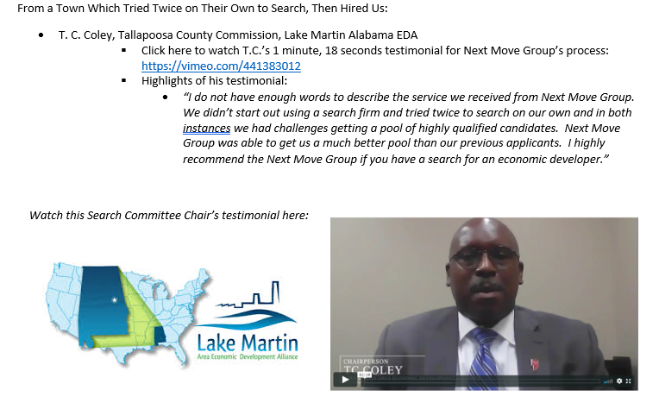
Testimonials:

Slide 22

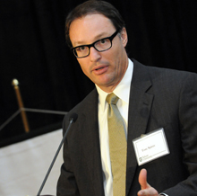
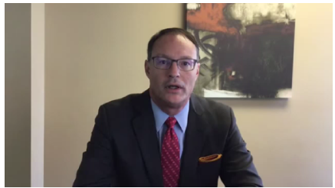
Testimonials:
“I would have to say the executive search we conducted with Next Move Group was done at the highest professional level and was the most well-organized search I have been involved with in quite a while. I have been a healthcare administrator for many, many years both private as well as public and university healthcare and I can say that I have been part of many executive searches and the way the Next Move Group conducted our search was probably the most professional I have been part of, I wholeheartedly recommend the Next Move Group.”
Tom Spiers, Board Chairman, World Trade Center of New Orleans
Listen Now
Hear Tom Spiers recommend the Next Move Group.

Slide 23
Contact Us

Slide 24
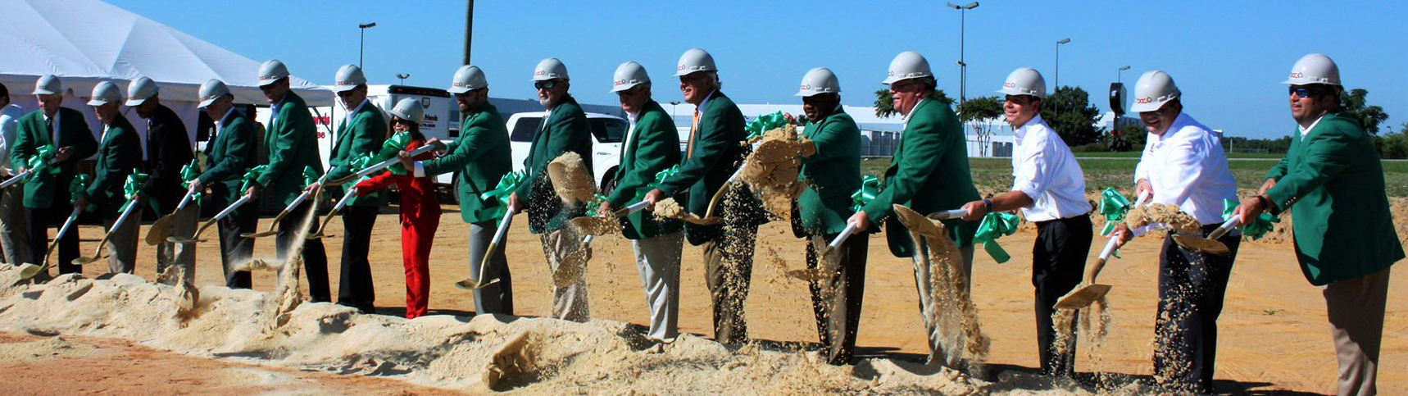

Contact Us
https://www.thenextmovegroup.com/executive-searches
Chuck Sexton, CEO
1-800-764-3105
chuck@nextmovegroup.com
www.nextmovegroup.com

